Slide 1



Facebook Page Engagement Analysis
A Case study that explores the posting and engagement behaviour of Facebook Pages across various categories like Politician, Retail, Government, etc. using MS Excel
Presented By : Divya M
Notes:
https://www.freepik.com/free-vector/people-doing-different-actions_3521084.htm
https://www.freepik.com/free-vector/hand-drawn-people-doing-outdoor-activities_2620727.htm

Slide 2



Objective of the Study
01
Understand posting behaviour on facebook pages
02
Analyze patterns in user reactions
03
Determine the best posting times
04
Discover themes in user comments

Slide 3
Datasets Used
PostSummary.xlsx: Post details like post time, category, page, and likes.
Comments.xlsx: Includes timestamps and content of comments.
Merged on Post ID (pid) for integrated analysis

Slide 4
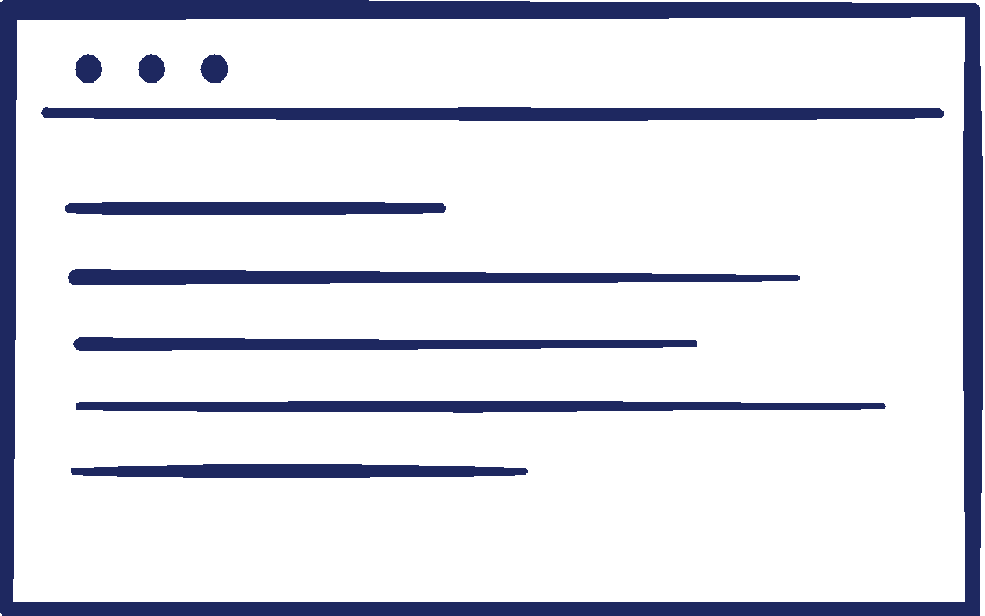
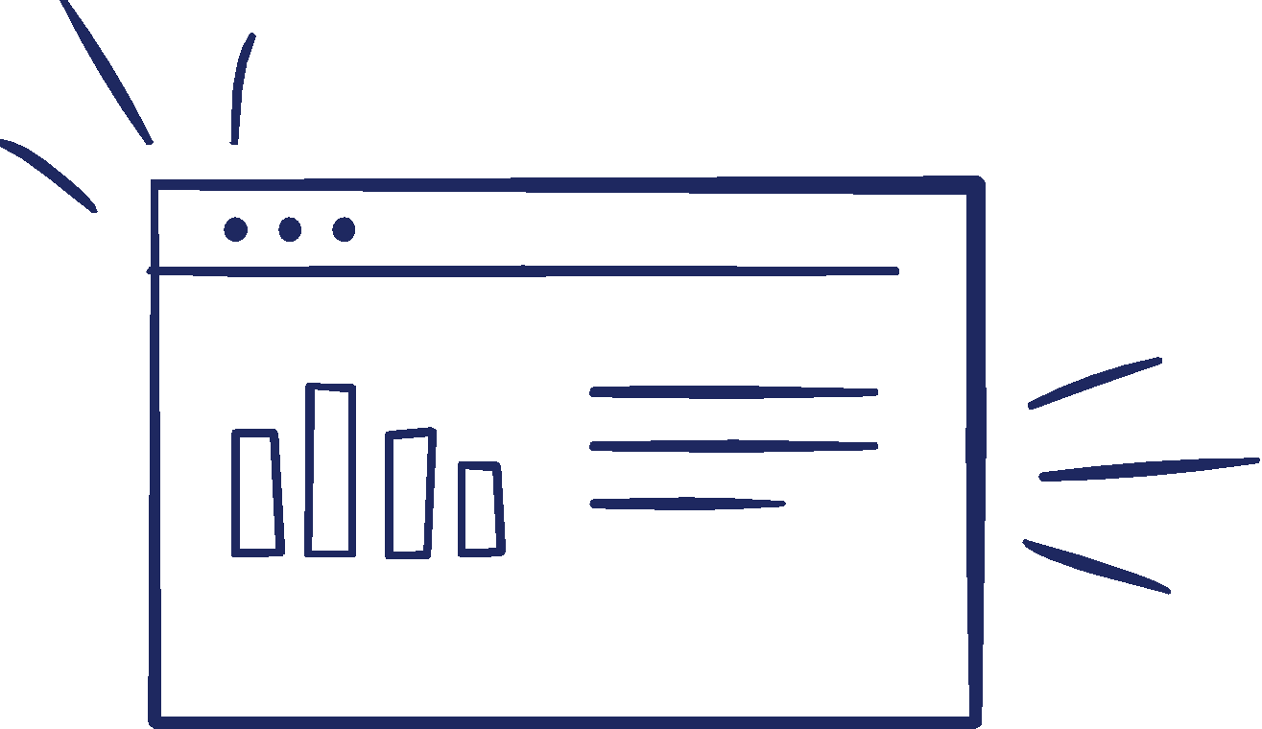
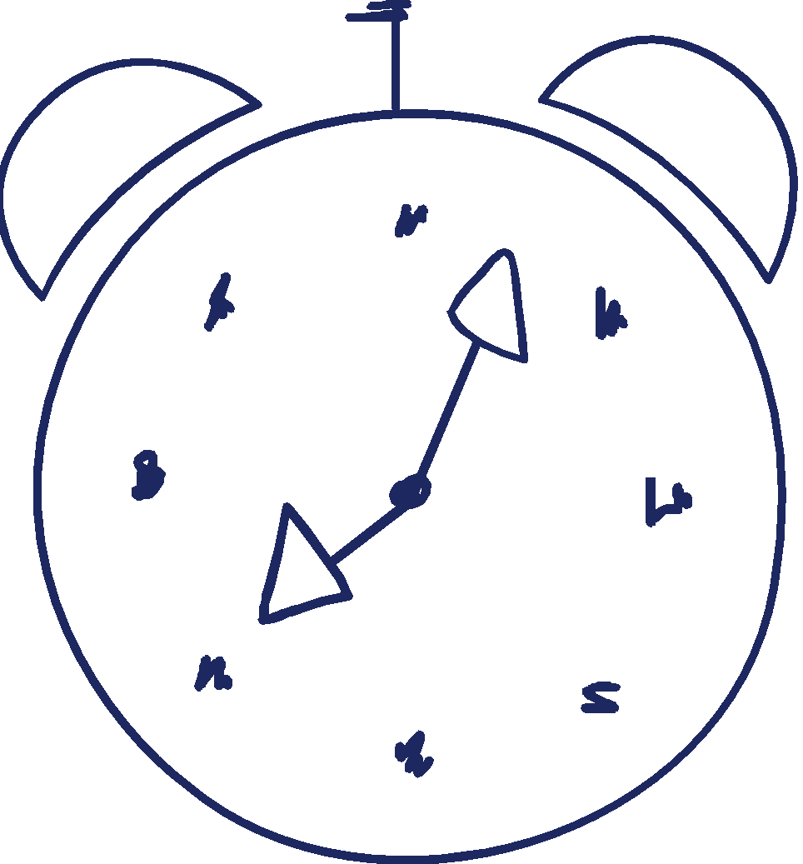
When Do Pages Post?
Focused on Traffic Police Pages (Bengaluru, Hyderabad, Kolkata)
Used 15-minute time buckets to analyze frequency
Most posts made between 10 AM to 4 PM (office hours)

Slide 6


When Do Users React?
Peak reactions:
12 PM–2 PM and 8 PM–10 PM
Analyzed Flipkart, Amazon, Snapdeal, Myntra pages
User engagement aligns with breaks and leisure hours
Opportunity to reschedule posts for higher visibility
Notes:
https://www.freepik.com/free-vector/facebook-background-with-likes-hearts_2528207.htm

Slide 8








Average Likes per category
E-commerce and Politics received more likes
Calculated average likes = Total Likes / Number of Posts
Popularity and relevance drive engagement
NGOs, Healthcare, Education saw fewer likes

Slide 10
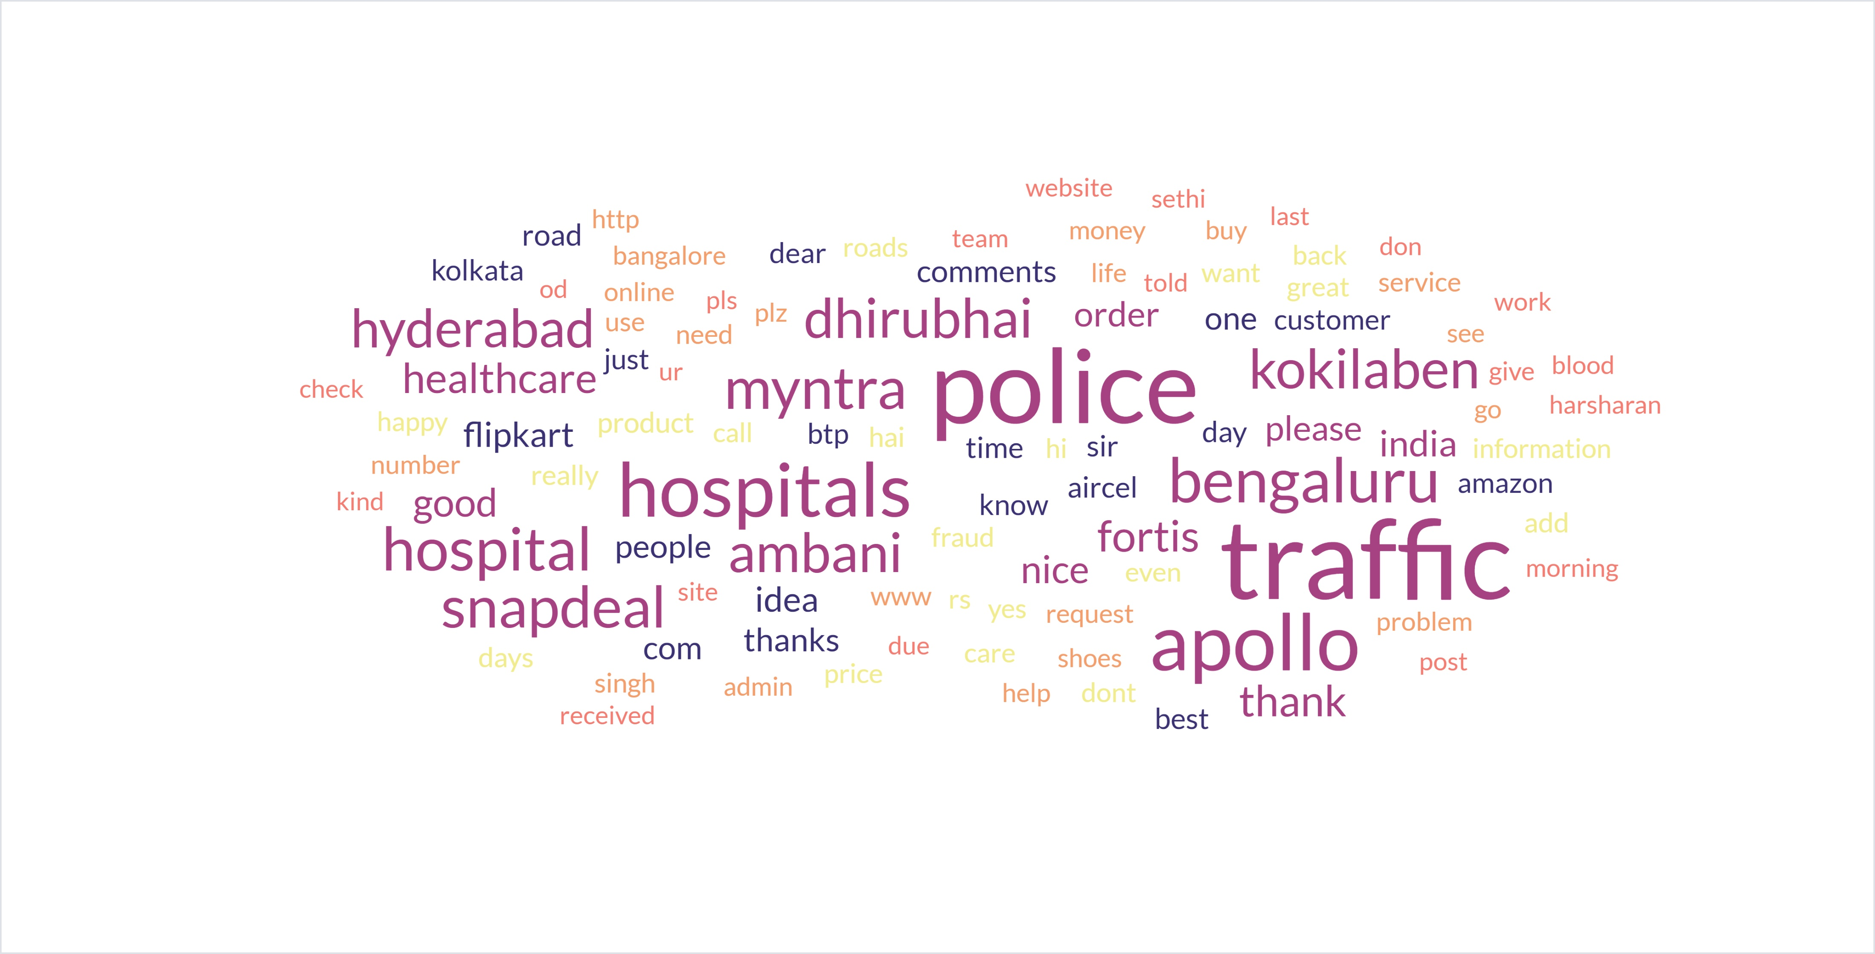
Word Cloud

Slide 11
Insights & Strategy: What We Learned
1
2
3
4
Time matters: Users are active when admins aren’t
E-commerce and Politics are naturally more engaging
Word clouds reveal customer sentiment themes
Optimize content timing and targeting using data
Notes:
https://www.freepik.com/free-vector/colorful-collection-with-great-variety-avatars_1258263.htm

Slide 12
Key Takeaways
01
Post timing impacts visibility and engagement
02
Category and content type affect likes
03
Comments provide insight into user concerns
04
Data + empathy = smarter content strategy
Notes:
Photo by William Poulos on Unsplash

Slide 13

Recommendations
Schedule posts during 12–2 PM or 8–10 PM
Align content with popular and relatable topics
Use word clouds to monitor sentiment trends
Continuously adapt based on engagement analytics
Notes:
https://www.freepik.com/free-vector/social-influencer-background_3466233.htm
https://www.freepik.com/free-vector/social-media-elements_2795653.htm

Slide 14




Conclusion
This case study highlights how the type of organization and the nature of their content significantly influence audience engagement on Facebook. Politicians attract more consistent interaction, while retail brands see spikes based on campaign success. Understanding these patterns helps businesses and public figures optimize posting strategies for better reach and reactions.
356
20

Slide 15
Thank You!

